Slide 1
Split-Attention Principle
Exploring the Split-Attention Effect & Cognitive Load Theory
Presented by: Rose Spivack & Ekam Gill • EDCI 337

Slide 2
SECTION 01 / MATERIALIZATION & APPLICATION
Demonstration A: Visual Disconnection - Git Workflow
☁️
G
F
Remote Repository
A
E
💻
D
C
B
Local Repository
DEFINITIONS
WORKFLOW STEPS
Local Repository = a private workspace stored directly on your computer
Remote repository = a hosted version of the project stored on a cloud server
git clone = a command used to create a target copy of an existing remote Git repository on your local machine
git switch -c = create a new branch on your local machine and switch to that newly created branch
git add = a command used to move changes from your working directory into the staging area
git commit = a command used to commit your staged changes with an inline description
git push = a command used to upload local repository commits to a remote repository
Pull Request = a formal proposal to merge code changes from one branch into another on the cloud
Merge to main = the action of combining completed work into the primary, production-ready branch of a project on the cloud
A: git clone
B: git switch -c {new branch name}
C: git add -A
D: git commit -m ‘{descriptive message}’
E: git push
F: Pull Request
G: Merge to main

Slide 3
SECTION 01 / MATERIALIZATION & APPLICATION
Demonstration B: Spatial Integration - Git Workflow
☁️
7. Merge to main: the action of combining completed work into the primary, production-ready branch of a project on the cloud
1. git clone: a command used to create a target copy of an existing remote Git repository on your local machine
6. Pull Request: a formal proposal to merge code changes from one branch into another on the cloud
Remote Repository: a hosted version of the project stored on a cloud server
5. git push
origin/master {branch name}: a command used to upload local repository commits to a remote repository
4. git commit
-m ‘{descriptive message}’:
a command used to commit your staged changes with an inline description
💻
3. git add -A: a command used to move changes from your working directory into the staging area
2. git switch -c {new branch name}: create a new branch on your local machine and switch to that newly created branch
Local Repository: a private workspace stored directly on your computer

Slide 4
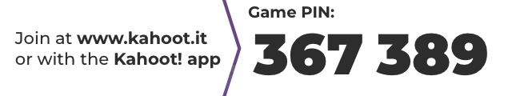

SECTION 01 / MATERIALIZATION & APPLICATION
Kahoot!

Slide 5
SECTION 02 / THEORETICAL FOUNDATION
Defining the Principle
Split-Attention Principle:
Learning improves when related pieces of information are physically and temporally combined, rather than separated

Slide 6
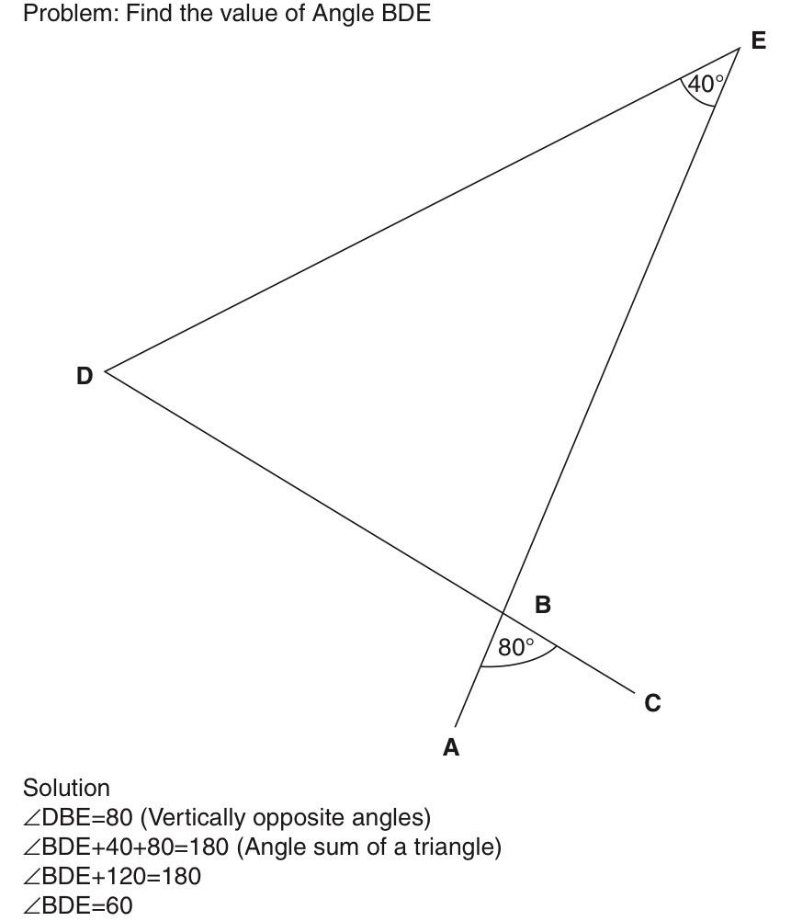
SECTION 02 / THEORETICAL FOUNDATION
Cognitive Mechanisms: Split-Attention Format
Extraneous Cognitive Load
⬆️ Extraneous cognitive load
⬇️ Learning
Working Memory Constraints
⬆️ Working memory load
⬆️ Information stored in temporary storage
Visual Search Strain
⬆️ Unnecessary searching
⬆️ Mental integration
⬆️ Chance of following incorrect sequence
Fig. 1. Split-Attention Format Working Example (Ayres and Sweller).

Slide 7
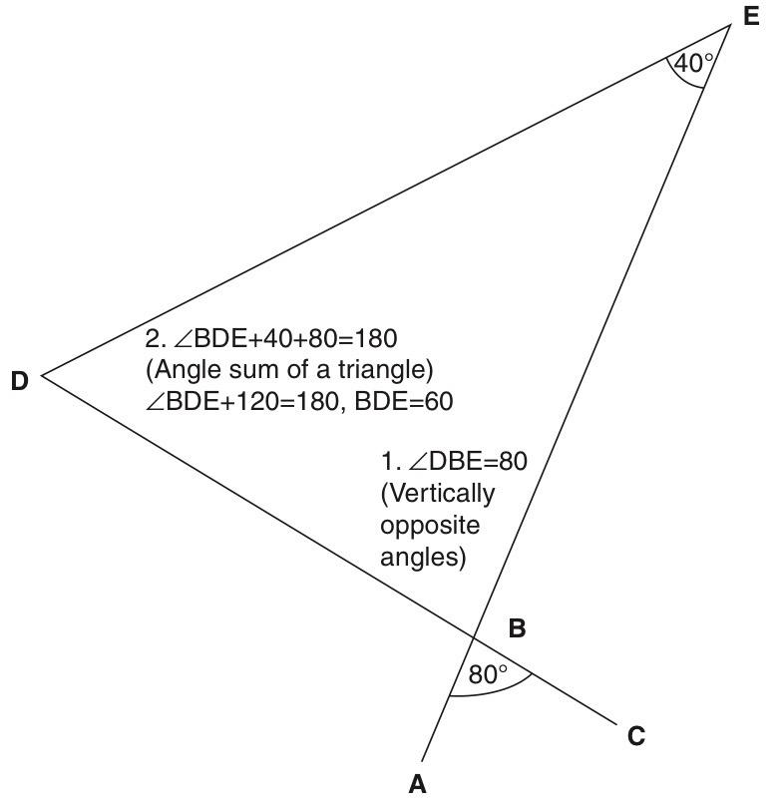
SECTION 02 / THEORETICAL FOUNDATION
Cognitive Mechanisms: Integrated Information Format
Extraneous Cognitive Load
⬆️ Temporal integration
⬇️ Extraneous cognitive load
⬆️ Learning
Working Memory Constraints
⬆️ Working memory resources focused on learning
⬇️ Information stored in temporary storage
Visual Search Strain
⬇️ Unnecessary searching
⬇️ Mental integration
⬇️ Chance of following incorrect sequence
Fig. 2. Integrated Format Working Example (Ayres and Sweller).

Slide 8
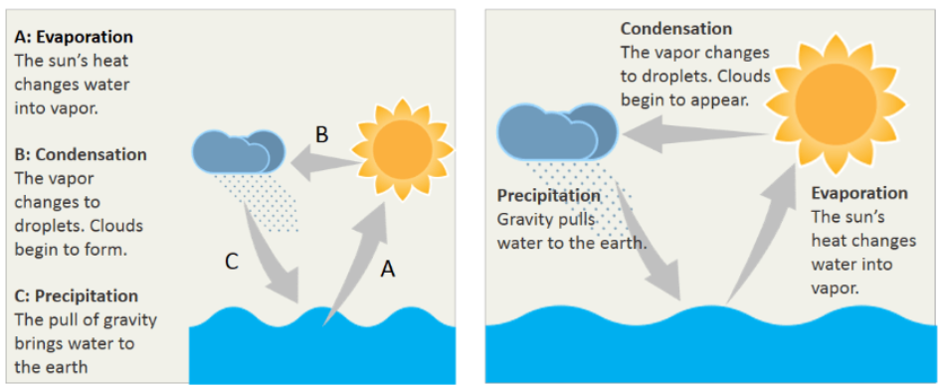
SECTION 02 / THEORETICAL FOUNDATION
Cognitive Mechanisms: Explanatory Text
Split-Attention Format
Integrated Information Format
Fig. 3. Explanatory Text Example (Nemesh).

Slide 9
SECTION 02 / THEORETICAL FOUNDATION
When Does Split-Attention Matter?
Mutual Dependence Rule
AKA Unintelligible in Isolation
The principle only applies when multiple sources of information cannot be understood on their own.
If a diagram or a text block makes perfect sense by itself, forcing them into an integrated layout yields no cognitive benefit.
Complexity Threshold
AKA High Element Interactivity
The principle only applies to material with high intrinsic cognitive load.
Simple concepts with few interacting pieces doesn’t strain working memory. Therefore, separating them won’t hurt learning.
Learner Factor
AKA Levels of Learner Expertise
High interactivity depends entirely on the characteristics of the learner.
What is a highly complex and confusing concept for a beginner is often simple and involves low-interactivity for an expert. Integration should be tailored to the prior knowledge of the learner.

Slide 10
SECTION 03 / ACADEMIC RESEARCH
Empirical Literature
Cognitive Load and Learner Expertise: Split Attention and Redundancy Effects in Reading with Explanatory Notes
By Alexander Seeshing Yeung, Putai Jin, John Sweller
Strategies to reduce the effect should depend on the students’ age and ability level
Older students with higher ability: separate lists of definitions worked better
Extra definitions within the text created unnecessary cognitive load and reduced comprehension
Younger students with lower ability: definitions placed directly within the text, did not have to search for definitions further than the text
These practices reduced the Split-Attention Effect and improved comprehension
The Split-Attention Effect as a Factor in the Design of Instruction
By Paul Chandler and John Sweller
How does information layout affect our cognitive load?
Participants were told about a process using either an integrated format (text and diagram combined) or separate format (text and diagram shown separately
Students who received integrated instructions scored higher on the test
Takeaway: Combining related text and diagrams can improve learning

Slide 11
SECTION 03 / ACADEMIC RESEARCH
Empirical Literature
Two Principles of Multimedia Learning: Redundancy and Split Attention
By Connie Malamed
Strategies to help reduce the split attention effect
Integrate text directly into animations
Thoughtfully control timing into animations
Give students control over animations
Replace written explanations with audio
Spatial Contiguity and Spatial Split-Attention Effects in Multimedia Learning Environments: A Meta-Analysis
By Noah L. Schroeder & Ada T. Cenkci
Split attention issues may be caused by more than just physical distance
Use of visual cues to guide student’s attention to where is important
Working memory is used differently when information is separated (positively and negatively)
Takeaway: Better learning processes did not always lead to better test results

Slide 12
SECTION 04 / EXPERIENTIAL NARRATIVE
Reflections on Personal Learning
Ekam
Rose
Lecture Slides Disconnect: Experienced lecture slides that were not temporally integrated.
Separated Documentation: Difficult to understand and debug code when documentation is not inline and many lines of code above.
Takeaway: Memory improved when personal notes include words, labels, and diagrams integrated physically and temporally.
Unnecessary effort: Realized how much subconscious effort it takes to switch between resources while studying. A new subject amplifies this difficulty
Decrease in Focus: Takes focus away from understanding the material and puts it toward figuring out how information is organized and related
Takeaway: I can’t change the textbook but I can figure out how to organize my notes. When finding learning resources for myself, I will pay more attention to how they are designed and organized.

Slide 13
SECTION 05 / CONTEMPORARY EVALUATION
Validity in the Modern Landscape
Generative AI Ecosystems
Can create learning resources catered to each student’s needs
Can explain complicated concepts in simpler ways but also overwhelm students with too much information or even false information
Social Platforms & Shorts
Short videos can summarize topics and combine visuals, texts, and audio as needed to explain concepts
Captions and labels help students to understand information
Notifications, comments, advertisements can be distracting
Advanced Dev Tools & Systems
Allows people to create interactive videos, diagrams, and other learning resources
Allows students to pause or slow down content at a pace that works for them
Too many graphics or effects trying to keep content exciting can be distracting

Slide 14
Discussion Questions
Do you think social media platforms such as TikTok and Youtube help split attention or create more distractions?
Have you ever spent more time figuring out how information was organized than actually learning the material?
Do you find it easier to learn when text and visuals are combined or do you prefer them separated?

Slide 15
References
Ayres, Paul, and John Sweller. "Split-Attention Principle: People Learn Better When Words and Pictures Are Physically and Temporally Integrated." The Cambridge Handbook of Multimedia Learning, edited by Richard E. Mayer, Cambridge University Press, 2005, ch. 8.
Nemesh, Ann. "4 Tips To Combine Text And Graphics For Better eLearning." eLearning Industry, 12 May 2021, https://elearningindustry.com/4-tips-combine-text-and-graphics-for-better-elearning
Attention: How digital technologies influence what we notice, what we focus on, and how we learn. (2022, October 27). Institute for Security and Technology. https://securityandtechnology.org/virtual-library/report/attention-how-digital-technologies-influence-what-we-notice-what-we-focus-on-and-how-we-learn/
Chandler, P., & Sweller, J. (1992). The split‐attention effect as a factor in the design of instruction. British Journal of Educational Psychology, 62(2), 233–246. https://doi.org/10.1111/j.2044-8279.1992.tb01017.x
Inner Drive. (n.d.). The split attention effect: A quick guide | InnerDrive. Retrieved October 28, 2026, from https://www.innerdrive.co.uk/blog/the-split-attention-effect/
Malamed, C. (2019, August 18). Two principles of multimedia learning: Redundancy and split-attention. The eLearning Coach. https://theelearningcoach.com/media/how-to-integrate-multimedia-for-effective-learning/
Yeung, A. S., Jin, P., & Sweller, J. (1998). Cognitive load and learner expertise: Split-attention and redundancy effects in reading with explanatory notes. Contemporary Educational Psychology, 23(1), 1–21. https://doi.org/10.1006/ceps.1997.0951

